Slide 1

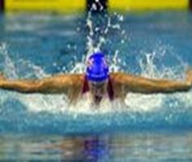
Home
Squads
Fixtures list
Contact Us
RSC Swimming Club

Slide 2
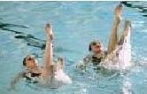
Welcome to the RSC Swimming Club Homepage
You have reached the home of RSC Swimming Club
The Club was founded in 1949 and has members of all ages
Whatever your ability from beginner to highly trained competiton swimmer we have a squad for you
All squads are trained using friendly ASA Qualified Coaches who would be pleased to discuss your needs
Dive in, splash around and have a look at our website
We look forward to seeing at the pool

Slide 3

RSC Swimming Club has a number of Squads.
These are defined as detailed below:
Tadpoles - This is a beginner group for the under 10 year olds learning to swim
Frogs - This is for the more mature learner wanting to take up swimming
Minnows - This is the first of the skill development for those who can swim
Piranahs - This is for the more serious swimmer competing at District level
Sharks - For the serious competitor
Synchro - This is our Synchronised Swimming Squad led by one of the top coaches in the country
Masters - This squad is for swimmers aged over 25
There is a place for any swimmer at any level to join a squad and take part

Slide 4
Note to self:
Try make it look similar

Slide 5
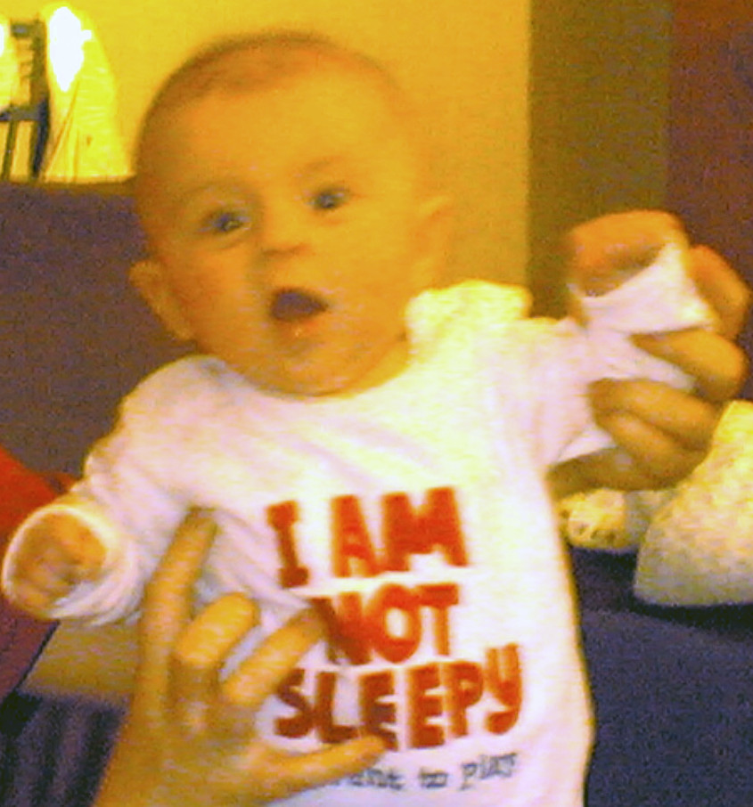
Contact us
Link
Email
RSC Swimming Club can be contacted as shown below:
Martin Davies Leisure Centre Bath Road Rockingham B54 7XX Tel: 01876 645231 on Monday Nights between 6pm & 9pm
Billiton Lodge School Billiton B54 7AA Tel: 01876 554231 on Tuesday, Wednesday & Thursday nights 6pm - 9pm
RSC Swimming Club Secretary: 75 Newchurch Lane Wolsgrave B52 9QY Tel 01876 654221
Or by using the e-mail link button below.
Don't leave it too long to make a splash!!!

